Slide 1
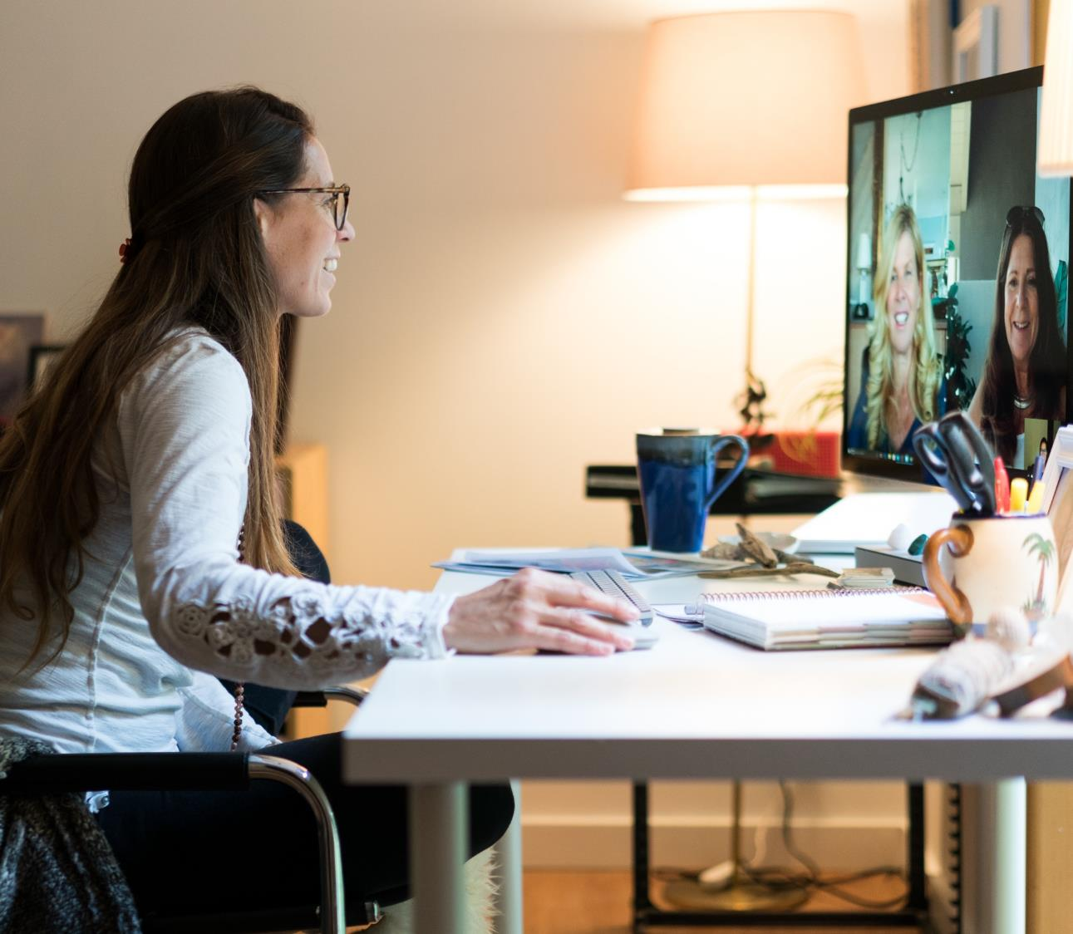
12 Maintaining a Single Source of Truth

Slide 2
Single Source of Truth
In information systems design, a single source of truth (SSOT) model stores every piece of information exactly once.
Any possible links to this information are by reference only.
Because all other locations of the data refer back to the "source of truth", updates propagate to the entire system without the possibility of data duplication or versioning errors.

Slide 3

Single Source of Truth: The Agenda
Time | Topic | Owner
9:00 | Welcome | Renee
9:30 | Champion Updates | John
10:30 | Break
11:00 | Business Review | Sanjay
11:30 | Open Q & A | Christi
12:00 | Lunch
Sanjay
Agenda V3
Agenda
Video
Diego
Q1
Agenda V2
Agenda V3 - Final
Agenda V3 – Final Final Final – LOCK - FINAL
Agenda V3 – Final Final

Slide 4



Single Source of Truth: The Agenda
TO:
Planning Committee
So Excited!
SUBJECT:
Town Hall Agenda
Me Too
Thanks everyone for your input.
Our agenda is at http://link-to-the-thing
Please click the link for updates
Thanks everyone for your input.
Thanks everyone for your input.
Our agenda is here
Please click the link for updates
Agenda.xlsx
Type your reply

Slide 5

Diffusion of Responsibility
Diffusion of Responsibility is a sociopsychological phenomenon whereby a person is less likely to take responsibility for action when others are present.
Kassin, Fein; Markus, Burke (2013). Social Psychology. Toronto: Nelson Education
TO:
Everyone
TO:
Nick
SUBJECT:
Town Hall Meeting
SUBJECT:
Town Hall Meeting
Please finish your content two days before the event.
Hi Nick! I need you to finish your content two days before the event.

Slide 6




Presentation Delegation
Can you do a presentation on our top partners at the Town Hall meeting?
John’s up next for “Industry Partnership… where is he?
I could talk our green initiative with Fabrikam?
I’ll have a presentation on Industry Partnerships
Hi I’m Maria, here to talk about Fabrikam!
Carlos
Wonderful!
Make it So!
? ? ?
John
Heidi
Aimee
Time | Topic | Speaker
9:00 | EOR | John
John
Poor schmuck running event
Maria (Subject Matter Expert)
Maria

Slide 7





Carefully Planned Agenda
Time | Topic | Owner
9:00 | Welcome | Renee
9:30 | Digital Transformation | John
10:30 | Break
11:00 | Business Review | Sanjay
11:30 | Open Q & A | Christi
12:00 | Lunch
Presenter
Renee
Maria
Ty
Alan
Video?
X
X
Demo?
X
PC?
X
Sponsor
http://

Slide 8
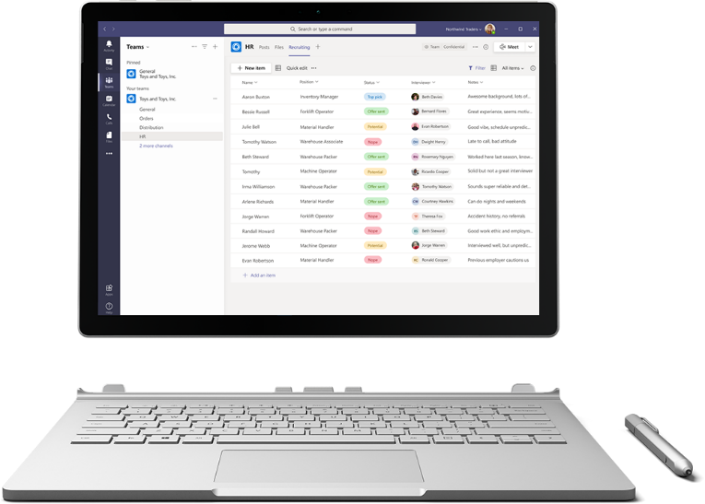
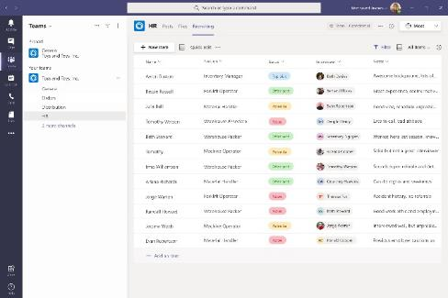

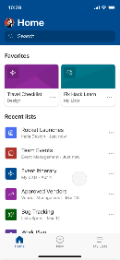
Track what matters most with Microsoft Lists
Simple
Easily create, share, and track lists with anyone, on any device
Smart
Keep everyone in sync with rules and quick edits
Flexible
Customize your lists for whatever your business needs

